Slide 1

OVERVIEW OF AWS SAGEMAKER BUILT-IN ALGORITHMS
EASY
ADVANCED

Slide 2
SAGEMAKER AVAILABLE ALGORITHMS
CLASSIFICATION
Linear Learner
XG-Boost
K-Nearest Neighbors (KNN)
Factorization Machines
REGRESSION
Linear Learner
XG-Boost
K-Nearest Neighbors (KNN)
COMPUTER VISION
Image Classification
Object Detection
Semantic Segmentation
DIMENSIONALITY REDUCTION
Principal Component Analysis (PCA)
Object2Vec
TIME SERIES FORECASTING
DeepAR
RECOMMENDATION
Factorization Machines
TEXT AND TOPIC MODELING
Blazing Text
Neural Topic Modelling (NTM)
Latent Dirichlet Allocation (LDA)
Sequence2Sequence
ANOMALY DETECTION
Random Cut Forest
IP Insights
CLUSTERING
K-Means
KNN

Slide 3
SAGEMAKER AVAILABLE ALGORITHMS
BlazingText Word2Vec | BlazingText implementation of the Word2Vec algorithm for scaling and accelerating the generation of word embeddings from a large number of documents.
DeepAR | An algorithm that generates accurate forecasts by learning patterns from many related time-series using recurrent neural networks (RNN).
Factorization Machines | A model with the ability to estimate all of the interactions between features even with a very small amount of data.
Gradient Boosted Trees (XGBoost) | Short for “Extreme Gradient Boosting”, XGBoost is an optimized distributed gradient boosting library.
Image Classification (ResNet) | A popular neural network for developing image classification systems.
IP Insights | An algorithm to detect malicious users or learn to usage patterns of IP addresses.
K-Means Clustering | One of the simplest ML algorithms. It’s used to find groups within unlabeled data.
K-Nearest Neighbor (k-NN) | An index based algorithm to address classification and regression based problems.
Latent Dirichlet Allocation (LDA) | A model that is well suited to automatically discovering the main topics present in a set of text files.
Linear Learner (Classification) | Linear classification uses an object’s characteristics to identify the appropriate group that it belongs to.
Linear Learner (Regression) | Linear regression is used to predict the linear relationship between two variables.
Neural Topic Modelling (NTM) | A neural network based approach for learning topics from text and image datasets.
Object2Vec | A neural-embedding algorithm to compute nearest neighbors and to visualize natural clusters.
Object Detection | Detects, classifies, and places bounding boxes around multiple objects in an image.
Principal Component Analysis (PCA) | Often used in data pre-processing, this algorithm takes a table or matrix of many features and reduces it to a smaller number of representative features.
Random Cut Forest | An unsupervised machine learning algorithm for anomaly detection.
Semantic Segmentation | Partitions an image to identify places of interest by assigning a label to the individual pixels of the image.
Seqence2Sequence | A general-purpose encoder-decoder for text that is often used for machine translation, text summarization, etc.
Source: https://aws.amazon.com/sagemaker/build/

Slide 4
LINEAR LEARNER IN SAGEMAKER
EASY
ADVANCED

Slide 5

SIMPLE LINEAR REGRESSION 101: SOME MATH!
In simple linear regression, we predict the value of one variable Y based on another variable X.
X is called the independent variable and Y is called the dependant variable.
Goal is to obtain a relationship (model) between outside air temperature and ice cream sales revenue
MODEL! (GOAL)
$$y=b+m∗x$$
$20
REVENUE($)
DEPENDANT VARIABLE
REVENUE ($)
INDEPENDENT VARIABLE
TEMPERATURE (DegC)
+10 degC
TEMPERATURE (DegC)

Slide 6
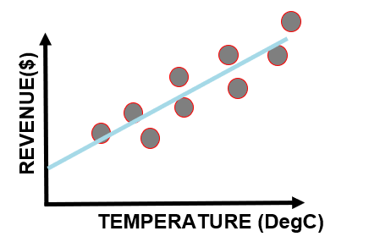
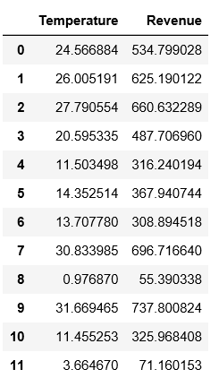
SAGEMAKER LINEAR LEARNER: OVERVIEW
Linear Learner is a supervised learning algorithm that is used to fit a line to the training data.
It could be used for both classification and regression tasks as follows:
Regression: output contains continuous numeric values
Binary classification: output label must be either 0 or 1 (linear threshold function is used).
Multiclass classification: output labels must be from 0 to num_classes - 1.
The best model optimizes either of the following:
For regression: focus on Continuous metrics such as mean square error, root mean squared error, cross entropy loss, absolute error.
For classification: focus on discrete metrics such as F1 score, precision, recall, or accuracy.

Slide 7
SAGEMAKER LINEAR LEARNER: USE CASES
DISCRETE BINARY CLASSIFICATION
Does this patient have a disease or not?
DISCRETE MULTICLASS CLASSIFICATION
Should an autonomous car stop, slow down or accelerate?
REGRESSION TASKS
Revenue predictions based on previous years performance.

Slide 8
SAGEMAKER LINEAR LEARNER: OVERVIEW
Preprocessing
Normalization or feature scaling is offered by Linear Learner (which is great!)
Feature scaling is a critical preprocessing step to ensure that the model does not become dominated by the weight of a single feature.
Training
Linear Learner uses stochastic gradient descent to perform the training
Select an appropriate optimization algorithm such as Adam, AdaGrad, and SGD
Hyperparameters can be selected and tuned (Example: learning rate).
Overcome model overfitting using L1, L2 regularization
Validation
Trained models are evaluated against a validation dataset and best model is selected based on the following metrics:
For regression: mean square error, root mean squared error, cross entropy loss, absolute error.
For classification: F1 score, precision, recall, or accuracy.

Slide 9

SAGEMAKER LINEAR LEARNER HYPERPARAMETERS
Predictor_type: ‘regressor’
Learning Rate: The step size used by the optimizer for parameter updates.
L1: L1 regularization parameter.
Mini_batch_size: The number of observations per mini-batch
Wd: The weight decay parameter, also known as the L2 regularization parameter.
Check out the rest of hyperparameters here: https://docs.aws.amazon.com/sagemaker/latest/dg/ll_hyperparameters.html

Slide 10
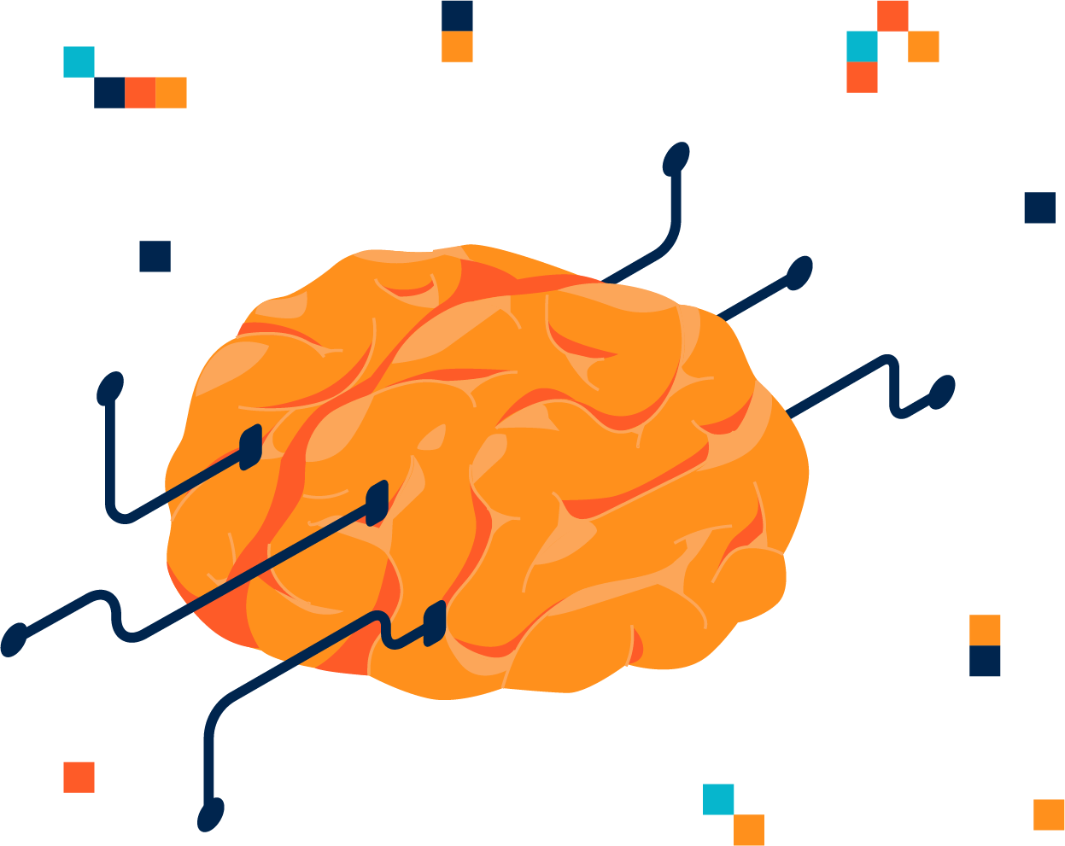
SAGEMAKER LINEAR LEARNER: INPUT/OUTPUT DATA
Amazon SageMaker linear learner supports the following input data types:
RecordIO-wrapped protobuf (note: only Float32 tensors are supported)
Text/CSV (note: First column assumed to be the target label)
File or Pipe mode both supported
For inference, linear learner algorithm supports the application/json, application/x-recordio-protobuf, and text/csv formats.
For regression (predictor_type='regressor'), the score is the prediction produced by the model.

Slide 11

SAGEMAKER LINEAR LEARNER: EC2 INSTANCE
Linear Learner algorithm could be trained on:
Single CPU and GPU instances
Multi-Machine CPU and GPU instances
During testing, multi-GPU computers are not necessary (add cost with no value).

Slide 12
LINEAR LEARNER MODEL TRAINING DEMO
EASY
ADVANCED

Slide 13
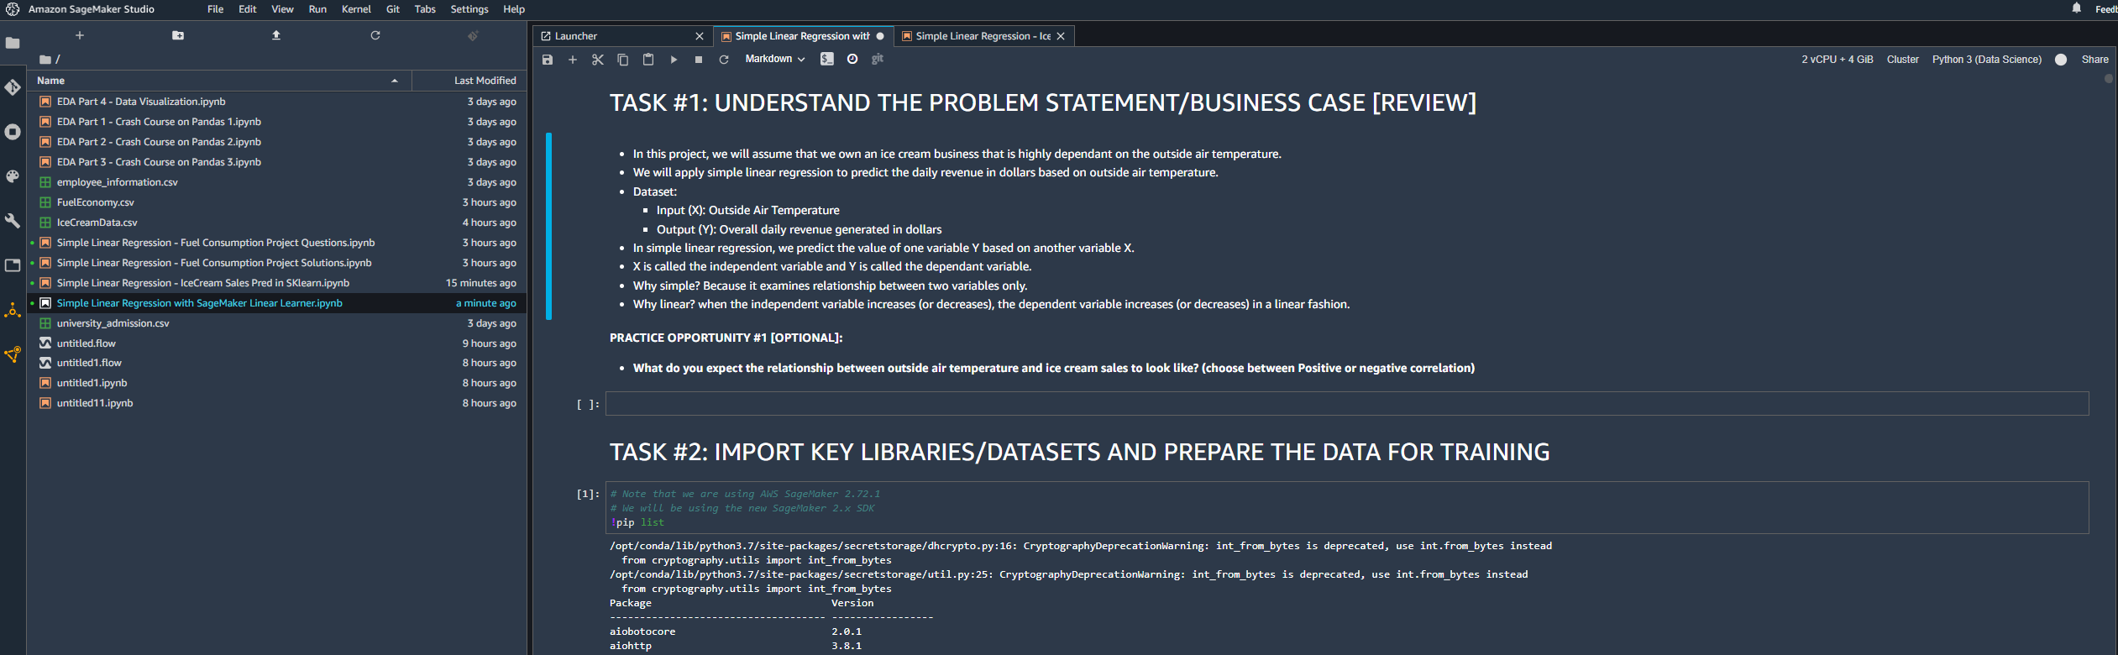
LINEAR LEARNER MODEL TRAINING DEMO:

Slide 14
END-OF-DAY FINAL PROJECT
EASY
ADVANCED

Slide 15
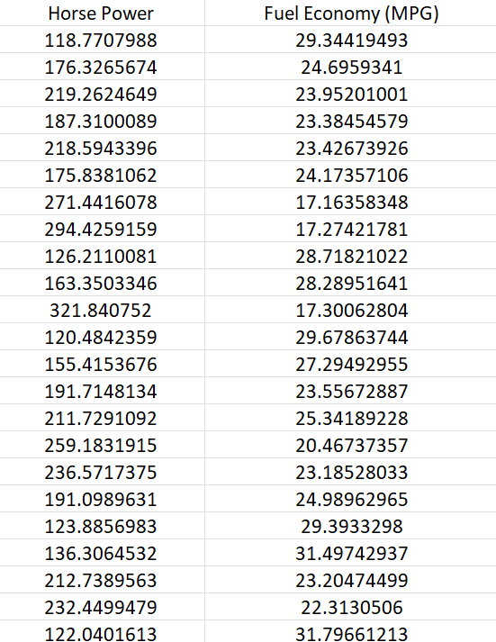
PROJECT OVERVIEW
You have been hired as a consultant to a major Automotive Manufacturer and you have been tasked to develop a model to predict the impact of increasing the vehicle horsepower (HP) on fuel economy (Mileage Per Gallon (MPG)). You gathered the following dataset:
Independent variable X: Vehicle Horsepower
Dependent variable Y: Mileage Per Gallon (MPG)

Slide 16
PROJECT TASKS
Using AWS SageMaker, perform the following:
1. Load the “FuelEconomy.csv” dataset to S3
2. Split the data into 80% for training and 20% for testing
3. Train a linear learner regression model using SageMaker SDK
4. Deploy trained model as an endpoint
5. Assess trained model performance, what is R2?
6. Delete the endpoint

